Slide 1
PEGASUS: Pre-training with Extracted Gap-sentences for Abstractive Summarization
Bumjin Park

Slide 2
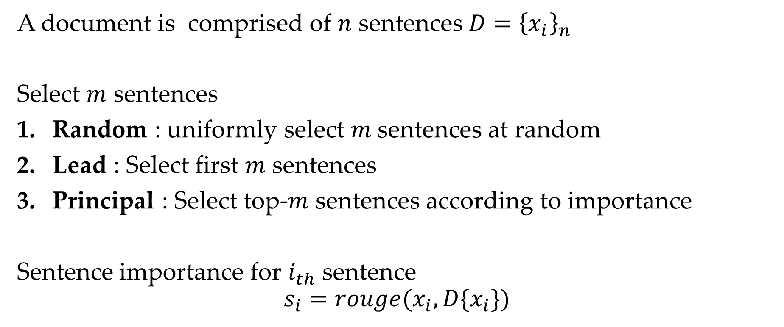
Gap Sentences
A document is comprised of $n$ sentences $D={\left\{x_{i}\right\}}_{n}$
Select $m$ sentences
Random : uniformly select $m$sentences at random
Lead : Select first $m$ sentences
Principal : Select top-$m$ sentences according to importance
Sentence importance for $i_{th}$ sentence $$s_{i}=rouge(x_{i}, D\{x_{i}\})$$

Slide 3
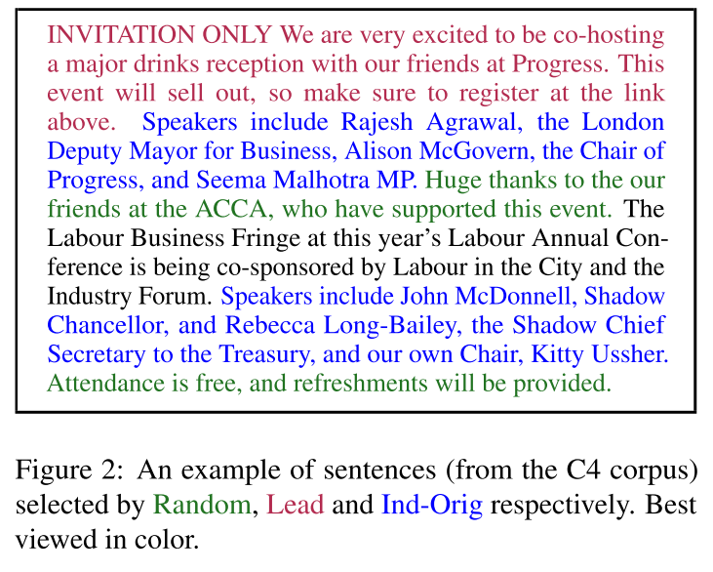
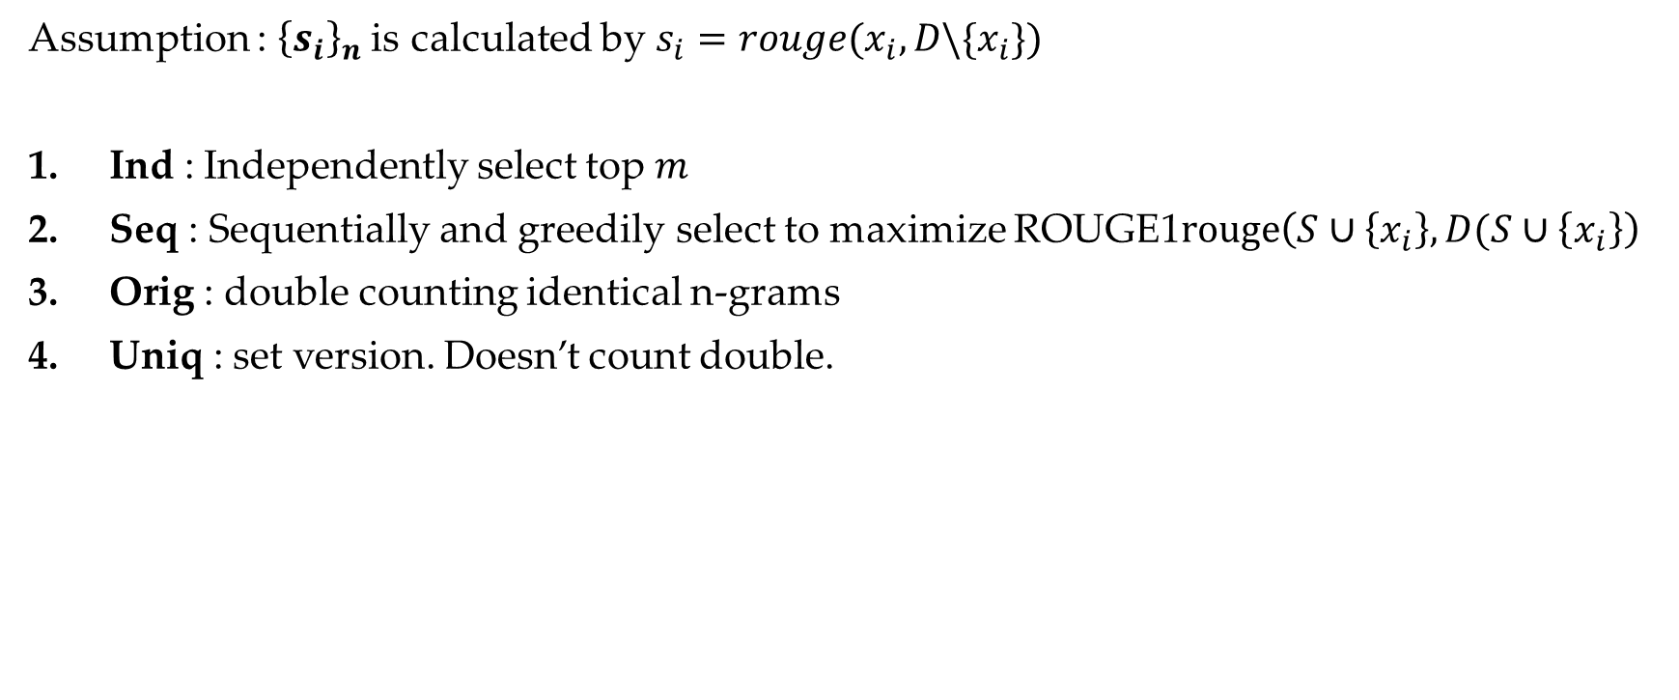
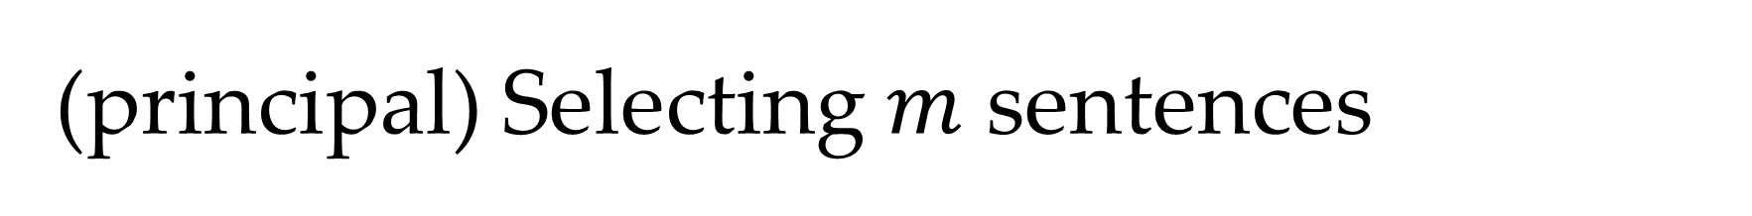
(principal) Selecting $m$ sentences
Assumption : ${\left\{s_{i}\right\}}_{n}$is calculated by $s_{i}=rouge(x_{i}, D\backslash \{x_{i}\})$
Ind : Independently select top $m$
Seq : Sequentially and greedily select to maximize ROUGE1$rouge\left(S∪\left\{x_{i}\right\}, D(S∪\left\{x_{i}\right\}\right)$
Orig : double counting identical n-grams
Uniq : set version. Doesn’t count double.

Slide 4

Gap Sentence Generation
A document is comprised of $n$ sentences $D={\left\{x_{i}\right\}}_{n}$
$m$ sentences ${\left\{{\hat{x}}_{i}\right\}}_{m}$ are fully masked and the decoder generate it.
Generation
Encoder
Decoder
Masked
Sentence Level
Token Level

Slide 5
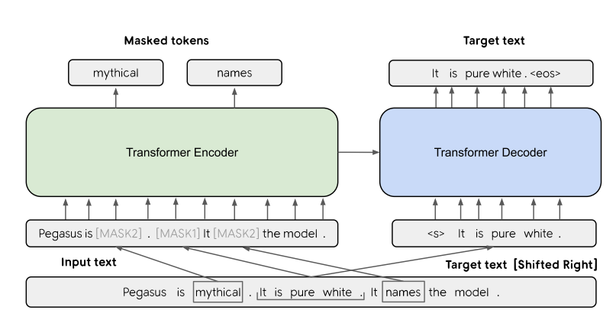
GSG and MLM combined pretraining
* There are 3 sentences
MASK1 for GSG generation
MASK2 for MLM

Slide 6
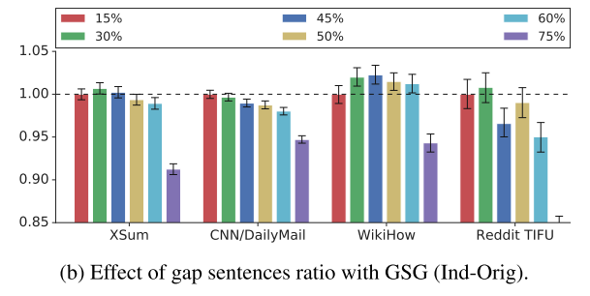
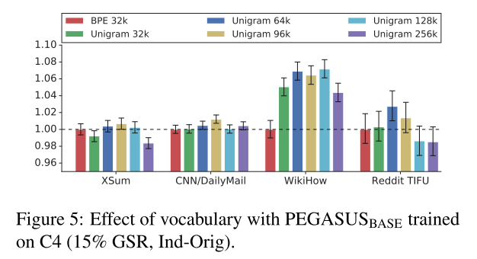
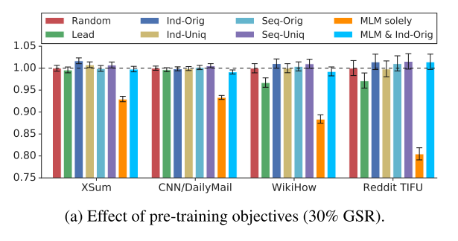
Experiments
GAP %
VOCAB
Sentence Importance

Slide 7
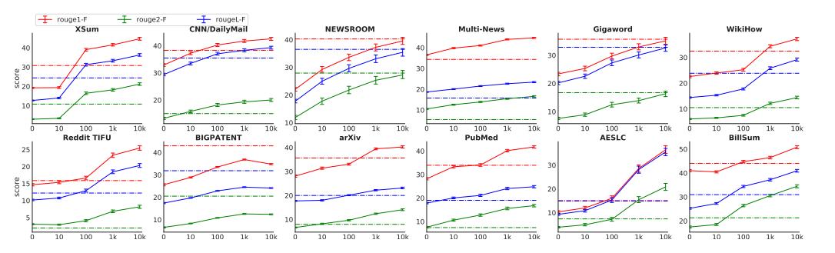
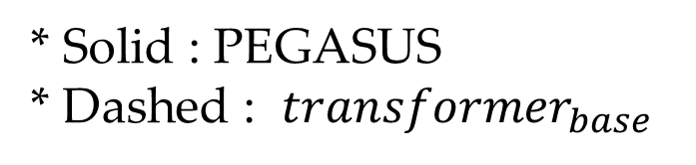
Training Data size and ROUGE score
* Solid : PEGASUS
* Dashed : $transformer_{base}$

